Slide 1
Accessing Medicaid Waivers a training designed for individuals with brain injury and the personal and professional people who support them
Erin Haw & Elizabeth Horn
Senior Disability Rights Advocates
disAbility Law Center of Virginia
July 13, 2022

Slide 2
What are you about to learn?
Virginia’s Medicaid waivers: what are they and how can they help a person with a brain injury (BI) live in their home or another community setting
Specific services offered by each waiver & related criteria
How to apply for and answer waiver screening questions to ensure approval
How to document a brain injury and appeal a denial if necessary
Resources to help you, your loved one, or your client apply
Notes:
Elizabeth

Slide 3
What is a waiver?
The federal Medicaid agency (CMS) allows state Medicaid agencies (like DMAS) to offer 1915 (c) waivers to limited groups of people as an alternative to institutional care
When someone has a waiver, they receive services similar or identical to the services offered in an institution but in their own home or community instead
Virginia's current Medicaid waivers offer alternatives to care in:
Intermediate Care Facilities (ICFs)
Nursing Facilities (NFs)
Waiver names and types vary from state to state and, unfortunately, don't transfer across state lines
Notes:
Erin

Slide 4
Waiver financial criteria
CHILDREN
No resources limit for children
The parent's income never disqualifies (as it does for SSI)
ADULTS
Adults access waivers through SSI/SSDI/Medicaid Disability
Resource limit is $2000 and is based on the applicant's resources
Resources in the applicant's name above $2000 must be in a Special Needs Trust or an ABLE account
Applicant can have income up to $2523 per month (2022)
Notes:
Erin
Medicaid waivers offer an important pathway to general Medicaid health care coverage for children and married adults who otherwise would not be eligible based on their family's combined income

Slide 5
VA has 4 waivers for eligible individuals
3 Developmental Disability (DD) waivers
Community Living (CL) waiver
Family and Individual Supports (FIS) waiver
Building Independence (BI) waiver
CCC Plus waiver*
Notes:
Erin
*formerly known as the Elderly and Disabled with Consumer Direction (EDCD) waiver

Slide 6
DD Medicaid Waivers
Notes:
Erin:
…let’s start with the “Developmental Disability” waivers...
how is a “developmental disability” or DD defined?

Slide 7
A developmental disability is a severe, chronic disability that meets 5 criteria…
1
2
3
Is a physical and/or mental condition…
…that began before age 22, and…
…is likely to continue indefinitely, and…
Notes:
Erin
Diagnostic Eligibility Review form: https://sccmtraining.partnership.vcu.edu/supportcoordination/chapter5/downloadables/Ch%205%20Diagnostic%20Eligibility%20Review%204%2019%2016.pdf
Definition comes from: https://law.lis.virginia.gov/vacode/title37.2/chapter1/section37.2-100/

Slide 8
…and meets at least 3 or more functional limitations
4
5
FUNCTIONAL LIMITATIONS
1. Self-care
2. Speaking & understanding language
3. Learning
4. Mobility
5. Self-direction
6. Ability to live independently
7. Ability to be financially self-sufficient
…requires many individualized services & supports that are long term or lifelong, and….
…results in substantial functional limitations in 3 or more areas of life:
Notes:
Erin

Slide 9
Can a brain injury be a developmental disability?
Yes!
If a traumatic or acquired brain injury occurred before age 22 and an individual otherwise meets the criteria for DD (i.e. severe, chronic, and results in at least 3 functional limitations), that person is considered to have a developmental disability regardless of their current age.
Many individuals in their 30s, 40s, 50s, and 60s are accessing the DD waiver by showing that their brain injury, brain tumor, or other brain event began before age 22!
Notes:
Elizabeth

Slide 10
VA’s 3 Developmental Disability waivers
Community Living (CL) Waiver
For children or adults with complex medical, behavioral, or support needs that require around-the-clock nursing or active services
Family and Individual Supports (FIS) Waiver
For children and adults living with their families or in their own home
Can include supports for some hours of the day & overnight monitoring
Building Independence (BI) Waiver
For adults who can live and work with a fair amount of independence but need periodic supports
Notes:
Erin

Slide 11
These waivers offer a wide array of services & supports
SERVICES TO ENABLE MEANINGFUL WORK & DAY ACTIVITIES
IMPORTANT EXTRAS
A PLACE TO CALL HOME
Sponsored Residential
Supported Living Residential
Group Home Residential
Shared Living
Personal Support Services
Workplace Assistance
Group Day Support Services
Non-Medical Transportation
Private Duty Nursing
Therapeutic Consultation
Crisis Support Services
Benefits Planning
Notes:
Erin
Social Security benefits planning is important if you want to work while maintaining a SS benefit
Complete DD Waiver Service List: https://www.dmas.virginia.gov/media/1178/dd-waivers-list-of-services-jan-2019.pdf
The Arc of Northern Virginia's All About Waivers: https://thearcofnova.org/programs/waivers/all-about-waivers/

Slide 12
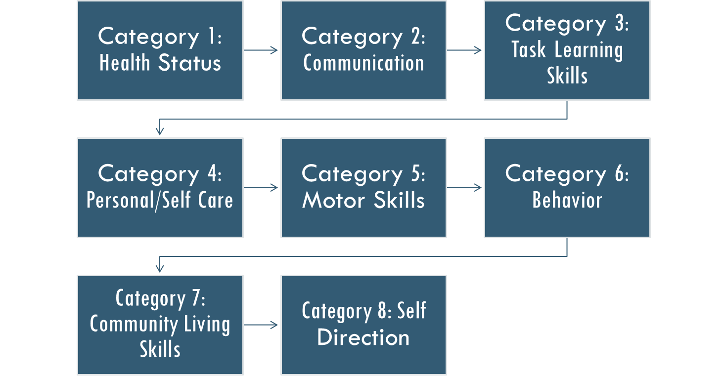
DD waiver screening tool
Virginia Individual
Developmental Disability Eligibility Survey
(VIDES)
Child VIDES (click here)
Adult VIDES (click here)
Notes:
Erin

Slide 13
TIPS for DD waiver approval
TIP 1
TIP 2
TIP 3
TIP 4
Make sure functional limitations are documented across all functional domains in the VIDES (use the BI Checklist & Quick Guide as your roadmap!)
Make sure the age the brain injury occurred is well documented along with the functional deficits at that time. If the date of injury is remote, use anything available to prove the date such as a newspaper article, family statements, etc.
Use objective evidence like: neuropsychological evaluations, social history, school IEPs, carefully phrased physician statements, etc.
If the individual is receiving Disabled Adult Child benefits on a parent’s social security record they have already proven disability onset before 22.
Notes:
Elizabeth

Slide 14
The DD waiver waiting list…apply NOW to get on!
Priority
1
Priority
2
Priority
3
Emergency Slots
Meets criteria and waiver is needed within 1 year
Meets criteria and waiver is needed within 1-5 years
Meets criteria and waiver is needed after 5 years
Assigned by DBHDS in accordance with state regulations*
Notes:
Erin – discuss how the state arrives at these priorities (e.g. having aging parents) and how people can move between priorities (parent dying, graduating high school, etc.)
The DD waivers have a combined waiting list with over 10,000 individuals waiting for a waiver slot
Community Service Boards (CSBs) throughout Virginia help enroll individuals in the DD waivers and manage the waiting list in collaboration with DBHDS and local Waiver Slot Assignment Committees (WSACs)
*12VAC30-122-90. Waiting list; criteria; slot assignment; emergency access; reserve slots: https://law.lis.virginia.gov/admincode/title12/agency30/chapter122/section90/
About a third of people on the DD waiver waiting list also qualify for the CCC Plus waiver.
1. Priority One shall include individuals who require a waiver service within one year and are determined to meet at least one of the following criteria:
a. An immediate jeopardy exists to the health and safety of the individual due to the unpaid primary caregiver having a chronic or long-term physical or psychiatric condition that currently significantly limits the ability of the primary caregiver to care for the individual; or there are no other unpaid caregivers available to provide supports;
b. There is immediate risk to the health or safety of the individual, primary caregiver, or other person living in the home due to either of the following conditions:
(1) The individual's behavior, presenting a risk to himself or others, cannot be effectively managed even with support coordinator-arranged generic or specialized supports; or
(2) There are physical care needs or medical needs that cannot be managed even with support coordinator-arranged generic or specialized supports;
c. The individual lives in an institutional setting and has a viable discharge plan; or
d. The individual is a young adult who is no longer eligible for IDEA services and has expressed a desire to live independently. After individuals attain 27 years of age, this criterion shall no longer apply.
2. Priority Two shall include individuals who will need a waiver service in one to five years and are determined to meet at least one of the following criteria:
a. The health and safety of the individual is likely to be in future jeopardy due to:
(1) The unpaid primary caregiver having a declining chronic or long-term physical or psychiatric condition that currently significantly limits his ability to care for the individual;
(2) There are currently no other unpaid caregivers available to provide supports; or
(3) The individual's skills are declining as a result of lack of supports;
b. The individual is at risk of losing employment supports;
c. The individual is at risk of losing current housing due to a lack of adequate supports and services; or
d. The individual has needs or desired outcomes that with adequate supports will result in a significantly improved quality of life.
3. Priority Three shall include individuals who will need a waiver slot in five years or longer as long as the current supports and services remain and have been determined to meet at least one of the following criteria:
a. The individual is receiving a service through another funding source that meets current needs;
b. The individual is not currently receiving a service but is likely to need a service in five or more years; or
c. The individual has needs or desired outcomes that with adequate supports will result in a significantly improved quality of life.

Slide 15
Advantages to applying for a DD waiver now
You’ll secure a place on the DD waiver waiting list
You’ll be in the system in case an emergency happens that moves you to Priority 1 or an emergency slot becomes available
Your developmental disability will already be documented if DD-specific crisis services are needed (i.e. REACH)
You’ll be eligible for annual Individual & Family Support Program (IFSP) funding
Being on the DD waiting list opens the door to case management services in some cases
Notes:
Elizabeth

Slide 16
The DD Waiver Application
If you have one, ask your brain injury case manager for help applying
Contact your local Community Services Board (CSB) and ask for the DD Intake Coordinator
Develop evidence in advance: you’ll be required to provide or obtain a psychological or neuropsychological evaluation
Review the VIDES carefully before you apply and plan your answers
Notes:
Erin
Your brain injury case manager can also help you access your CSB via Same Day Access when there is a brain injury with mental health concerns

Slide 17
Appealing a DD waiver denial
If denied, you have a right to appeal!
Appeal within 30 days of the denial decision.
Submit the appeal either:
online via DMAS’s appeal portal
by mail, fax, or in person using DMAS’s client appeal request form
You can re-apply anytime with new evidence.
Notes:
Erin

Slide 18
DD Waiver Resources
My Life, My Community
The Arc of Virginia or your local chapter of The Arc
disAbility Law Center of Virginia (dLCV)
Notes:
Erin

Slide 19
CCC Plus Medicaid Waiver
Notes:
Erin

Slide 20
CCC Plus Waiver Facts
This waiver has no waiting list!
Offers a home and community-based alternative to care in a nursing facility.
Serves children & adults across the lifespan as long as they continue to meet eligibility.
You must meet criteria: financial, functional, medical/nursing needs, and risk of nursing home placement.
Waiver services are reviewed, approved, and coordinated by a Managed Care Organization (MCO).
Notes:
Erin

Slide 21
CCC Plus waiver services
Private Duty Nursing (RN & LPN)
Personal Care Services
Assistive Technology
Environmental Modifications
Adult Day Health Care
Respite Services
Personal Emergency Response System (PERS)*
Transition Services
Notes:
Erin – includes both agency and consumer directed options
*Including for Medication Monitoring
Service Limitations:
• Personal Care—Soft cap of 56 hours per week, exceptions available based on criteria
• Respite –480 hours per State fiscal year
• Environmental Modifications -$5,000 per individual per calendar year
• Assistive Technology -$5,000 per individual per calendar year
• Private Duty Nursing –cannot exceed more than 112 hours per week
• Transition Services -$5,000 per individual per lifetime

Slide 22
All of Virginia's Medicaid waivers include "transition services"
Virginians with BI who reside in institutions can use Medicaid waivers to transition to community care. These institutions include:
NFs (both in-state and out-of-state facilities like Braintree Manor)
psychiatric hospitals
All of Virginia's Medicaid waivers include "transition services" which are:
nonrecurring set-up expenses for individuals who are transitioning from an institution or provider-operated living arrangement to a living arrangement in a private residence where the person is directly responsible for his or her own living expenses
ICFs
psychiatric residential treatment facilities (PRTFs)
Notes:
Erin
Transition services are capped at $5,000 per individual per lifetime.
Some Centers for Independent Living (CILs) will assist with institutional to community transitions as well. Find your local CIL here. Examples include, but are not limited to:
ENDependence Center of Northern Virginia: https://www.ecnv.org/content.asp?contentid=256
Endependence Center, Inc: http://endependence.org/deinstitutionalization/
The Peninsula Center for Independent Living: https://www.hvacil.org/our-services

Slide 23
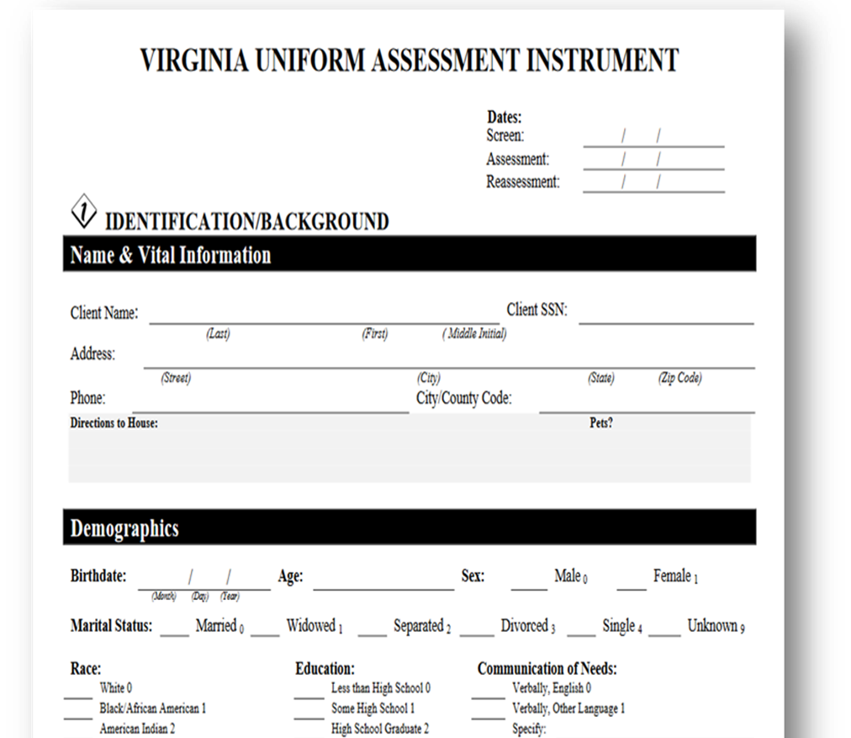
CCC Plus Waiver Screening Tool
Applicants are screened to see if they meet nursing facility level of care via the Uniform Assessment Instrument (UAI)*
Hospitalized individuals with severe brain injury may have a UAI automatically completed around the time of discharge by the hospital social worker
Before applying, you and a case manager can SELF ASSESS by using Mom’s in Motion DIY tool CCC Plus Self Eligibility Tool
Notes:
Erin

Slide 24
Brain Injury TIPS for CCC Plus Waivers
TIP 1
TIP 2
TIP 3
Before screening, use the Brain Injury CHECKLIST to pre-assess deficits across 4 domains:
Cognitive/communication
Physical
Psychological
Independent living
Ensure all functional limitations and care needs are well documented in the medical and psychological record.
Be sure to accurately report these limitations to your doctors, psychologists, and therapists!
During screening, make sure questions are answered using your “worst day” of the week. This is not the time to discuss your progress.
Notes:
Elizabeth

Slide 25
CCC Plus waiver applications
To apply, either:
contact your CCC Plus care coordinator (if you are already receiving healthcare coverage through a CCC Plus managed care plan) and ask them to initiate the waiver screening and enrollment process
contact the appropriate local Department of Social Services (DSS) to request a CCC Plus/long term care screening (if you are not already receiving healthcare coverage through a CCC Plus managed care plan)
Individuals cannot be denied a CCC Plus/long term care screening
if you are denied a screening, you should request and obtain a written denial letter
Notes:
Erin

Slide 26
Appealing a CCC Plus waiver denial
If you apply for a CCC Plus waiver and are denied, you have the right to file an appeal
Appeals should be submitted to the state Medicaid agency, or DMAS, within 30 days of the adverse decision or action
Appeals can be submitted either:
online via DMAS's appeal portal
by mail, fax, or in person delivery using DMAS's client appeal request form
If you decide not to appeal, or you miss the appeal window, you can re-apply for a CCC Plus waiver at any time with new or enhanced evidence
Notes:
Erin

Slide 27
CCC Plus Resources
if CCC Plus healthcare services are already in place contact the MCO care coordinator, otherwise…
CCC Plus Advocates, VA Office of the State Long-Term Care Ombudsman
800-552-5019
Moms in Motion's Family Resource Specialists
800-417-0908 (select option 2 for waiver coaching)
disAbility Law Center of Virginia (dLCV)
800-552-3962
Notes:
Erin

Slide 28
Maintaining waivers at 18 depends on SSI eligibility
If, prior to 18, a child has a Medicaid waiver but is NOT receiving Supplemental Security Income (SSI) they must undergo a Medicaid “disability determination” before their 18th birthday to ensure there's no lapse in Medicaid, including waiver eligibility and services, as they move from child to adult Medicaid. They must also APPLY for SSI immediately upon turning 18. Medicaid will continue for one year while the adult undergoes SSI determination.
If, prior to 18, a child has a Medicaid waiver AND receives SSI, a “disability determination” for Medicaid is not required. In that case, the child will have an SSI “age 18 re-determination” completed by the Social Security Administration (SSA) when he or she turns 18. Medicaid will continue for one year while the adult undergoes SSI determination.
IMPORTANT INFORMATION FOR 17-YEAR-OLDS WITH WAIVERS ALREADY IN PLACE!
Notes:
Elizabeth

Slide 29
Other Services
Notes:
Erin

Slide 30
Individual and Family Support Program (IFSP)
IFSP is a Virginia specific program that helps individuals with DD and their families access person-centered and family-centered resources, supports, and services while they wait for a DD waiver slot to become available
IFSP includes a Community Coordination Program and a Funding Program
IFSP Funding can cover eligible costs that support continued living in an independent setting
A maximum of $1000 per fiscal year per person is available
IFSP funds are awarded as one-time funds and are not guaranteed to be awarded each year
Notes:
Erin
Full list of covered and non-covered services is available here: https://dbhds.app.box.com/s/409r8thvbruz18d2ocfj9azo9iiwc565
DBHDS IFSP page: https://dbhds.virginia.gov/developmental-services/ifsp
DBHDS IFSP Guidelines: https://dbhds.app.box.com/s/409r8thvbruz18d2ocfj9azo9iiwc565
DBHDS IFSP Video: https://www.youtube.com/watch?v=8VT9JyvtBI4

Slide 31
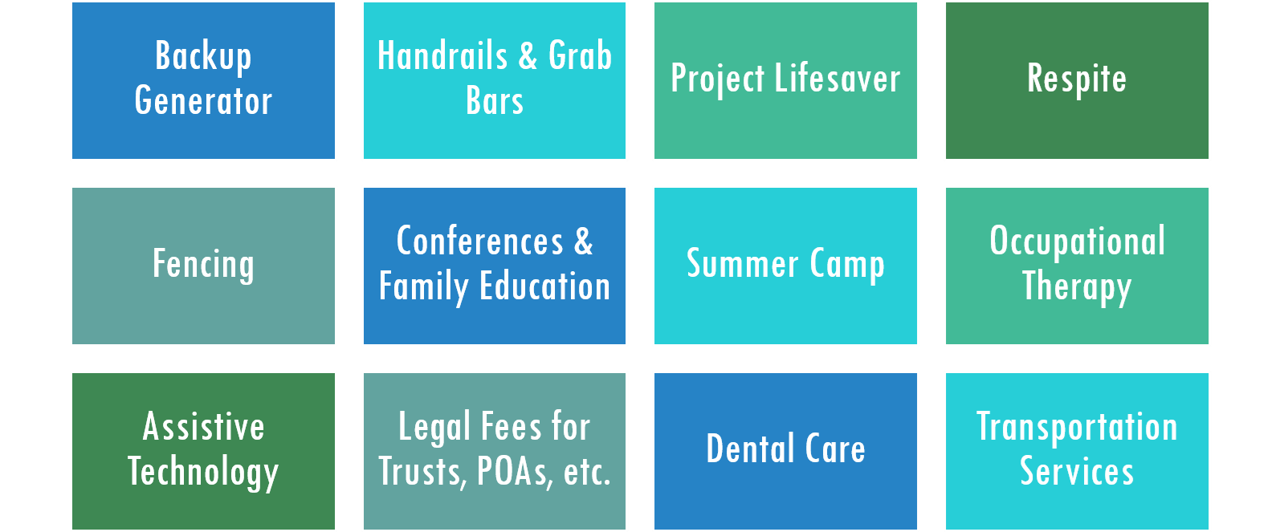
IFSP
Notes:
Erin
Camp Bruce McCoy – BI specific summer camp

Slide 32
Early Periodic Screening, Diagnosis, & Treatment (EPSDT)
A federal benefit that ensures people on Medicaid receive comprehensive and preventative health care services from birth through the end of their 20th year, including services that aren't normally covered in their individual state's Medicaid State Plan.
EPSDT is key to ensuring children and adolescents receive appropriate preventive, dental, mental health, developmental, and specialty services.
For individuals with BI under the age of 21, EPSDT can provide a helpful adjunct to other services (such as special education and waiver services), through the provision of rehabilitation, behavioral therapies, and much more!
Notes:
Erin

Slide 33
EPSDT
EPSDT is a benefit automatically available to anyone in Virginia under the age of 21 who has Medicaid - there is no separate application or enrollment process
For a service or device (such as assistive technology) to be covered under EPSDT, however, it must be medically necessary
Collaborate with doctors and other specialists (such as occupational therapists) to prepare detailed Letters of Medical Necessity is often essential!
Hard limits or caps on services are not allowed under EPSDT
Notes:
Erin

Slide 34
Regional Education Assessment Crisis Habilitation (REACH)
Provides 24x7 statewide crisis prevention, stabilization, and response services for individuals with developmental disabilities across the entire lifespan
Individuals must have a co-occurring mental illness and/or significant challenging behaviors that are active or cyclical in nature
Services include mobile response, which provides supports in the individual's home at the time of crisis, and short-term stays in a residential crisis program
REACH is funded and overseen by the state (i.e. DBHDS) but operated and administered locally by five regional programs
Notes:
Erin
Services are provided at no cost to the individual, their family, and their providers
You don't have to have Medicaid, a Medicaid waiver, or be on a Medicaid waiver waiting list to access REACH services
REACH does not have any immigration or income restrictions
Referrals and requests for REACH services can be made by individuals, families, and service providers
To apply for REACH, simply call the appropriate regional program's crisis hotline to request services
24x7 regional REACH crisis hotline numbers:
Region I: Charlottesville and Surrounding Areas (855) 917-8278 (adult)
(888) 908-0486 (child)
Region II: Northern Virginia
(855) 897-8278 (adult & child)
Region III: Southwest Virginia (855) 887-8278 (adult & child)
Region IV: Richmond and Surrounding Areas (855) 282-1006 (adult & child)
Region V: Southeast Virginia/Tidewater Area (888) 255-2989 (adult & child)

Slide 35
Brain injury TIP for REACH services
The only REACH requirement is that you have a developmental disability...you do not need to have a DD waiver in place.
If a person with a brain injury that occurred before age 22 has or is at risk of behavioral health issues, establish their DD status early to speed up crisis services!
DD waiver
Adult Disabled Child Benefit (SSD)
Good psychological or neuropsychological evaluation
School records
The key is to have this documentation ready before the crisis occurs!
Notes:
Elizabeth

Slide 36
Program of All-inclusive Care for the Elderly (PACE)
PACE provides comprehensive home and center based medical care and social services to eligible adults (age 55 or older) who meet nursing home level of care as assessed by the UAI
Most PACE participants are dually eligible for both Medicare and Medicaid
To apply, contact the PACE program serving your area: https://vapacealliance.org/pace-sites-in-virginia
Notes:
Erin
PACE providers receive monthly Medicare and Medicaid capitation payments for each enrollee
Medicare enrollees who are not eligible for Medicaid pay monthly premiums equal to the Medicaid capitation amount, but no deductibles, coinsurance, or any other type of Medicare or Medicaid cost-sharing
DMAS PACE Website: https://www.dmas.virginia.gov/for-providers/long-term-care/programs-and-initiatives/program-of-all-inclusive-care/
Applicable state regulations: https://law.lis.virginia.gov/admincode/title12/agency30/chapter50/section320/

Slide 37
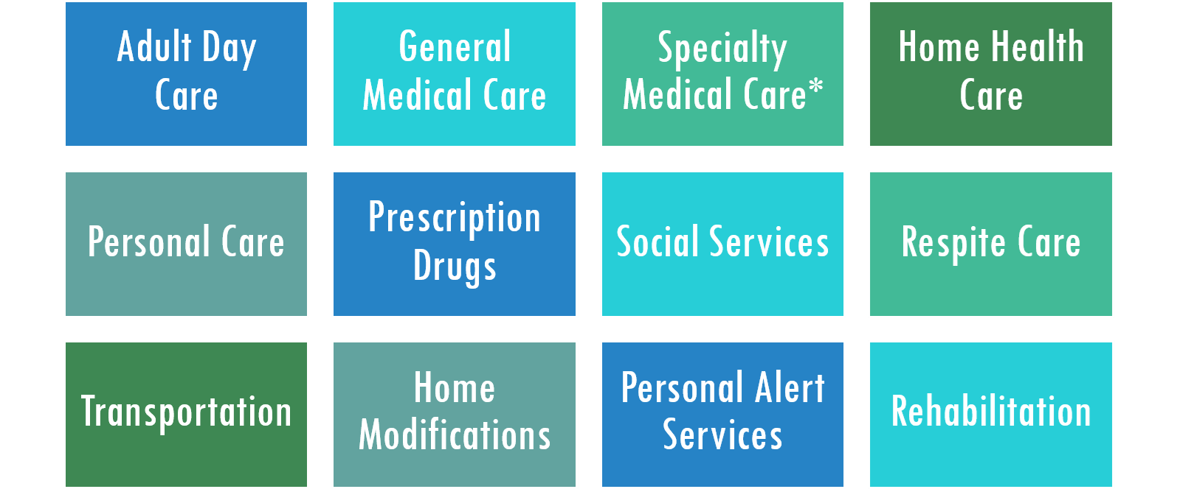
PACE Services
Notes:
Erin
*covers specialty medical care such as audiology, dentistry, optometry, podiatry, and speech therapy
PACE Fact Sheet: https://www.cccplusva.com/sites/default/files/Documents/VPA%20Information%20Sheet%2010-26-2018_.pdf

Slide 38
Q&A
Notes:
Erin & Elizabeth

Slide 39
CONNECT WITH US
ADDRESS
1512 Willow Lawn Drive Suite 100 Richmond, VA 23230
PHONE
1-800-552-3962 (toll-free) | 804-225-2042
GET HELP
dLCV.org/get-help
dlcv.org/podcast
@disAbilityLawVA
@disAbilityLawVA
facebook.com/ disAbilityLawVA

