Slide 1
Behavior Basics
Decoding the language behind FBAs and BIPs
Notes:
Hello, I’m Kalena Ek
And I’m Kerry Chilton.
We’re staff attorneys with the disAbility Law Center of Virginia, and we’d like to talk with you about the basics of behavior today. We know a lot of parents have no idea what to expect in the Functional Behavior Assessment and Behavior Intervention Plan process, so we wanted to take some time to explain the basics of behavior, so you can be a meaningful participant in the IEP and Behavior Intervention Plan development process.

Slide 2
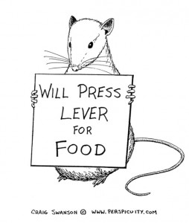
The ABCs of behavior
Antecedent
Behavior
Consequence
Notes:
Kerry
The very basics of behavior start with the ABCs – antecedent, behavior, and consequence.
Antecedent is just a fancy word for what happens before – what is the trigger that leads to the behavior. This can be tricky, because behavior doesn’t occur in a vacuum – there may be delayed antecedents, just as there are more immediate ones. Antecedents can be internal or external.
The behavior is the action (or thought, or speech) that you’re focused on. In the school context, this usually focuses on undesirable behavior, but as we’ll talk about more on the next slide, behavior is much broader than just the behavior getting our student into trouble. Behavior is not inherently bad!
And Consequence is what happens after the behavior, that serves to make the behavior more or less likely to happen in the future. These can be natural consequences, or artificially imposed.

Slide 3
What do you mean by behavior?
Behavior is anything a person or organism does
Speaking
Thinking
Moving
Not just “bad”
Specific
Measurable
Definable
Notes:
Kalena
There are a lot of different definitions for behavior, but broadly speaking, its anything a person DOES – this can include verbal behavior like speech, moving around, interacting with the world, and even more private behavior like thinking. Basically, if it’s alive, it has a behavior.
A lot of times, when we talk about behavior in the school/student world, the focus is on behavior that we don’t like; but, behavior is not just bad, or disruptive. Behavior, can be neutral or good, desirable. Those of you who have seen some of our other videos or presentations know, I spend a lot of my personal time hanging out with behavior analysts, and one of my favorite behavior analysts likes to say, “if you aren’t noticing the good behavior, then you’re not reinforcing it” – you’re not working to make it more likely to happen. So make sure, in your meetings or discussions, you’re talking about more than just the bad stuff.
When you’re talking about behavior you would like to change – that you’d like to make happen more or less often – you should define that behavior as specifically as possible. Sometimes we see students getting in trouble for “disrupting their peers,” while perhaps accurate, that’s the result of the behavior; as opposed to “tapping her pen repeatedly,” which is more specific.

Slide 4
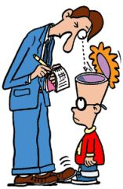
Functional Behavioral Assessments and Behavior Intervention Plans
Proactive approach to prevent behavior that would result in school discipline
Functional Behavioral Assessments are evaluations
Rule out medical causes first
Notes:
Kerry
You’re probably with us today because your child’s school or teachers or IEP team are talking about a Functional Behavioral Assessment (FBA) and Behavior Intervention Plan (BIP). As a brief overview, these are some of the most common tools schools use to meet their obligation to take a proactive approach to making sure students don’t have behaviors that are going to get them in trouble in the school setting. Students can also have behavior goals written into their IEPs, hopefully informed by the FBA/BIP process.
The road to getting a BIP in place starts with an evaluation called a Functional Behavioral Assessment (an FBA). We encourage you to take a look at the materials on our website about evaluations generally, but you should know that, like all evaluations, if you disagree with the school’s FBA, you can request an independent educational evaluation (an IEE) for an FBA, which the school must either pay for, or challenge via due process.
Who should complete an FBA or BIP? Just like you probably wouldn’t have a PE teacher conducting a reading assessment, functional behavioral assessments shouldn’t be done by just anyone. Years ago, we had a case where the school principal, who had no background in behavior, was doing all of the FBAs and BIPs for the school. As with all evaluations, they should be done by trained and knowledgeable personnel – behavior analysists are now licensed in Virginia, so that would by my first choice. You really want someone who knows what they’re looking at doing these assessments.
One quick word of caution before we go further – before you talk about addressing a student’s behavior, you’ll want to make sure you’ve ruled out any medical causes for the behavior first – things like blood sugar levels and thyroid function are just 2 examples we’ve seen in our practice that have effected a student’s behavior – and the best BIP in the world isn’t likely going to be helpful when the root cause is medical. We’re not doctors or clinicians, so please talk with your child’s doctor about any potential medical reasons for their behavior as part of this FBA/BIP process.

Slide 5
Functional Behavioral Assessments and Behavior Intervention Plans
Identifies the reason for inappropriate student behavior and creates a plan to prevent it going forward
10 step process
Verify seriousness of behavior
Define the behavior
Collect information on reasons for behavior (direct and indirect)
Analyze information collected
Develop a hypotheses about the function of behavior
Verify the hypothesis
Develop and implement a Behavior Intervention Plan (BIP)
Evaluate delivery of BIP
Evaluate effectiveness of BIP
Modify BIP
Notes:
Kalena
Ultimately, you want a BIP that figures out why your student is doing whatever behavior it is that’s getting them in trouble, and details how to make that not happen anymore.
So there’s a 10 step process goes like this. First – verify the seriousness of the behavior – as an example, we’ll say a student it “annoying the teacher” – is this a big deal? Maybe, maybe not something worth developing a plan for. Once we’ve determined this is a big enough problem that is needs an intervention, we look to define the behavior we’re targeting – tapping a pen; speaking without being called on in class – the more specific, the better, though I will caution going too far – I once had a client whose disciplinary review team decided the behavior in question (saying a specific curse word) wasn’t a manifestation because while they had a BIP in place to deal with him shouting curse words, this was a new and different word than they had planned for, so define the behavior reasonably specifically.
Then someone, ideally a Behavior Analyst, but it could be a teacher or parent or someone filling out an observation form the Behavior Analyst designed, collects information on the reasons for the behavior – this can be direct observation, or review of the discipline record, interviews with the student, parent, teachers. Then the Behavior Analyst gets to work Analyzing the data collected, looking for patterns, looking for those ABCs being repeated, and develops a hypothesis – an educated guess – about why that student is doing that behavior, and then verify that hypothesis and create a Behavior Intervention Plan – these are the positive and negative reinforcements we’ll use, this is how we’ll reduce or change the presentation of the antecedents if we can, that kind of thing.
After the plan is made, you still need to evaluate the delivery of the BIP – is this a plan everyone who needs to implement can implement, and the effectiveness of the BIP – is this plan, when implemented perfectly, working? And after that, make some changes based on that new information.

Slide 6
4 types of consequences - examples
 | Punishment (decreases likelihood of behavior) | Reinforcement (increases likelihood of behavior)
Positive (adding/ giving) | Write “I will not skateboard down the hall” 50 times | (not a bribe) Paycheck, Good grade on an assignment
Negative (taking away) | You may not have your skateboard for 3 weeks. Time-out | The overflowing garbage smells bad, so you take it out and now your kitchen smells lovely.
Notes:
Kerry
Consequences come in 4 basic types – consequences can be positive or negative, punishing or reinforcing – so you can have positive and negative reinforcement, and positive and negative punishment.
Think of positive and negative like you would in math – positive, plus sign, adding to; negative, minus sign, taking something away.
Reinforcement is usually something you like, something that’s more likely to make you repeat what you’ve done; punishment is an aversive – something you don’t like. These are not universal – not everyone finds the same things reinforcing or punishing – as an example, some kids love candy, others don’t; some kids really care about their grade on an assignment, others aren’t moved by it one way or the other, some kids hate running laps, others love it- so make sure any reinforcement selected is actually something that makes the behavior more likely to happen again.
We have some examples up on this slide of each of the 4 types of consequences
Positive punishment – that’s writing out lines repeatedly, running laps, that sort of thing
Negative punishment is things like time out, taking away your toys for 2 weeks
Positive reinforcement is your paycheck for going to work, a good grade on an assignment. Sometimes people say positive reinforcement is a bribe– but the big difference here is that, where a bribe comes before a behavior, the reinforcement comes after – and the same payment, used as a reinforcement, is much more likely to be successful. So saying, “if you sit in the cart quietly at the store, we can get ice cream AFTER” is going to be much more successful than “we’ll get ice cream now, but I expect that you’ll sit quietly in the cart at the store.”
Negative reinforcement is taking out the trash because it stinks, and after you take it out, it smells nice in your kitchen again; turning down the volume of a loud radio, taking off your shoe to shake out a pebble.
I will caution you here and say if you see punishment used in a BIP, that’s a red flag – what you really want a behavior plan to focus on is reinforcing the behavior you want to see.

Slide 7
How often should reinforcement happen?
Continuous
after every target behavior
Partial/Intermittent
Buy 10 coffees, get the 11th free
Payday every Friday
Slot machine payout
Timing is VERY IMPORTANT
Notes:
Kalena
Reinforcement can happen a few different ways, and each has their benefits and limitations. This may not come up in your discussions, but just in case it does, you’ll know what the terms mean in actual, practical use.
Continuous reinforcement happens after every single time the behavior you’re looking to increase happens – which is pretty time and resource intensive, and not a great way to keep a behavior going without that reinforcement or reward.
So your other option is partial or intermittent reinforcement. In these, the reward or reinforcement happens less often than continuous, based on either a ratio (a number of behaviors) or interval (a time period), and can be fixed or variable. We’ve got some examples up on this slide to give you an idea of what these schedules look like, but the model used in a slot machine payout – when the behavior of hitting the slot machine button gets rewarded after an unpredictable number of times – is the strongest method for getting a behavior to stick.
Keep these schedules in mind when you’re talking with the IEP team about the BIP, and figuring out what’s going to work best for your student and their classroom setup.
Also keep in mind that you’re reinforcing behavior, not people – so the timing of when the reward or reinforcement is given is extremely important. The most effective reinforcement happens immediately after the behavior – the longer it takes to get the reinforcement after the behavior happens, the weaker that reinforcement is, and it won’t be as effective.

Slide 8
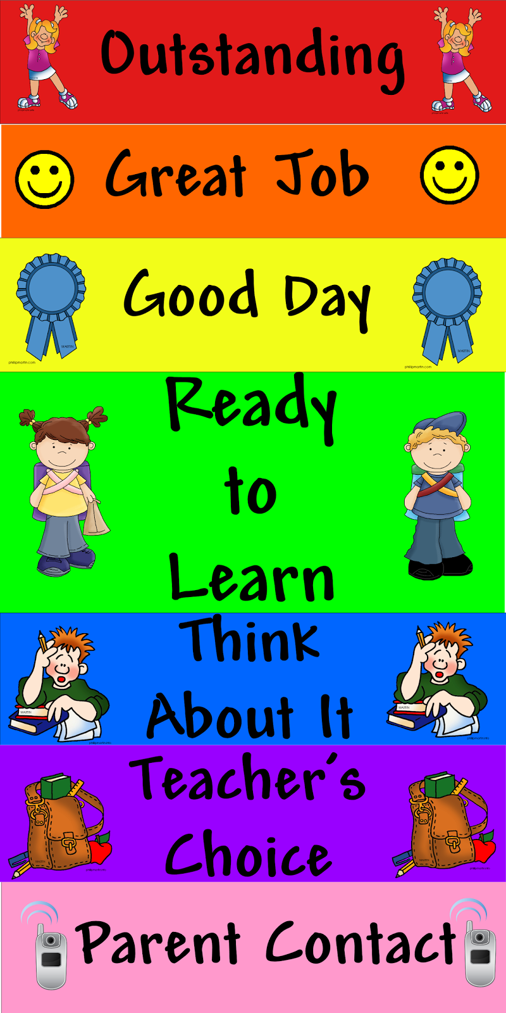
Common application in the classroom
Notes:
Kerry
Behavior isn’t just a concern for students with disabilities, and as schools in Virginia move to using PBIS (positive behavioral supports) school-wide, these behavioral interventions and concepts are found and applied in nearly every classroom.
2 examples I’d like you to think about are the behavior color chart - where the chart is posted somewhere public in the classroom with students names are on a clip that are moved up or down depending on their behavior, and an example you may know as a token economy system – a smiley face chart where students can earn smiles to be turned in for something reinforcing after a certain number are earned.
The behavior chart and the smiley face chart there are slightly different from each other, as the color chart includes a mix of positive reinforcement and punishment, whereas the smile chart (unless smiles can be taken away) provides just positive reinforcement.

Slide 9
What is the intended outcome?
Meet behavior goals in IEP
Plan to fade the reinforcer
Modify the BIP as the student grows and changes
Brace for the extinction burst
When reacting to a behavior you want to decrease, think about the future, not about just stopping the behavior now
Notes:
Kalena
As you’re talking with the IEP team about BIPs and behavior goals, it’s important to have an idea of what the endgame looks like – what happens when the behavior goals in the IEP are met? Is there more work to do, and new goals that will need to follow? If so, you’ll probably be looking at modifying the BIP to meet those new goals. Or, once the goals are met, if everything is pretty good, and we just want the student to be able to maintain those behaviors on their own, there needs to be a plan to fade, or taper off, the reinforecer – some reinforcers you don’t want or expect to fade – I love my job, but I wouldn’t be very likely to show up to work every day if I weren’t being paid – but in the context of the BIP, you’ll want to work with the team and behavioral professionals to include a plan to decrease the delivery of reinforcers while still maintaining the behaviors you want to see.
One thing to keep in mind, as the BIP gets put in place and you’re working to reduce or eliminate a particular behavior, is something called the extinction burst. Extinction burst works like this: the behavior you don’t like has been reinforced or rewarded before, and now you’ve stopped reinforcing it. That behavior increases in frequency, trying to get to the reward it’s gotten before. So, even with a great BIP in place, things may get worse before they get better. The good news is, if you stick to the plan and don’t provide the reinforcement at that burst, the behavior will reduce and eventually disappear entirely. Those of you who have gotten through the infant stage as a parent will be familiar with this if you’ve tried any version of the Cry It Out method to teach your child to sleep.
With that in mind, it is important to keep the long term goals in the back of your mind while you’re talking about behavior plans with the team – so often the focus is only on stopping the behavior in the moment. As you’re evaluating the plan, and as the plan is put in place, think about how these reactions, these consequences, set up the behaviors you want to see going forward.

Slide 10
Contact Us
Monday, Wednesday, Friday
8:30 am – 4:00 pm
Toll Free- 800-552-3962
info@dlcv.org
www.dlcv.org
Notes:
Thank you for joining us, we hope you found this information helpful. For more information about other special education topics, please see the resources available on our website. You can also find our contact information online.

